Slide 1
Los Angeles City 311 Data Analysis
Team SoCal Analytics
Feili Wu Jing (Helen) Wang Kshitij Kulkarni Sheng-Jhih (Ethan) Lin Ying Zhang

Slide 2


Agenda
Findings by Department
Findings by Service Types
Findings by Request Sources
Recommendations

Slide 3
Findings by Department

Slide 4
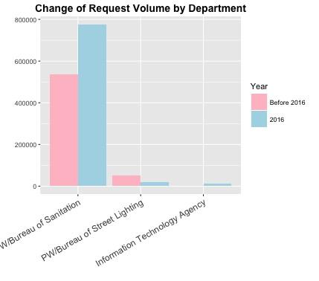
Request Distribution by Department
Before 2016, there were 6 departments processing service requests
In 2016, there are 7 departments
3 new departments created
Office of Community Beautification
Los Angeles Department of Water and Power
Bureau of Engineering
4 departments remain on duty:
Bureau of Sanitation (BOS)
Bureau of Street Lighting (BSL)
Information Technology Agency (ITA)
Bureau of Street Services (BSS)

Slide 5
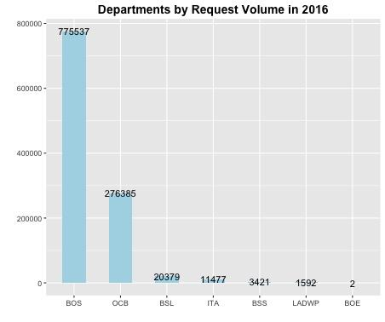
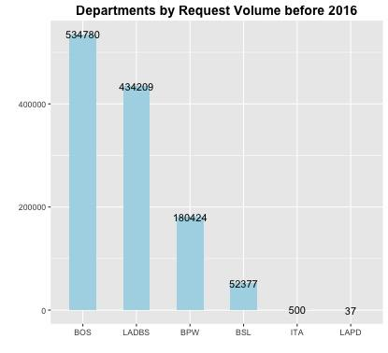
New Departments in 2016
Graffiti Removal | 276307
Feedback | 65
Other | 13
OCB - Office of Community Beautification, mainly responsible for graffiti removal, which was managed by Board of Public Works(BPW) and Los Angeles Police Department(LAPD) before 2016
LADWP - Los Angeles Department of Water and Power, mainly responsible for water waste cases, which was managed by Department of Water and Power(DWP)
BOE - Bureau of Engineering, only 2 requests reported in 2016
Report Water Waste | 1591
Feedback | 1

Slide 6
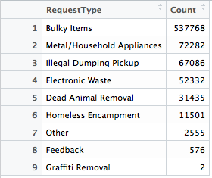
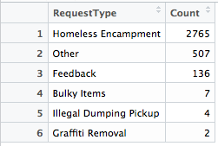
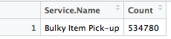
Department's Responsibility Change
Bureau of Street Services (BSS)
Before 2016, BSS didn’t really processed service. It transferred calls for street related services.
In 2016, BSS is mainly in charge of homeless encampment service.
Bureau of Sanitation (BOS)
BOS is mainly in charge of trash and dumping related issues.
BOS started to process homeless encampment in 2016.
Before 2016

Slide 7
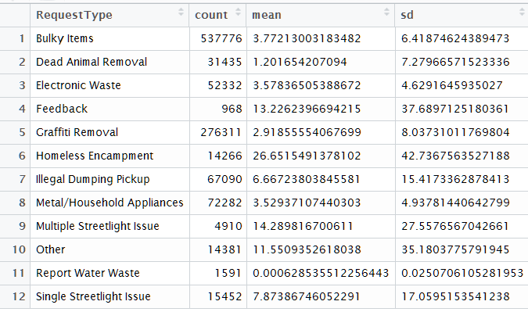
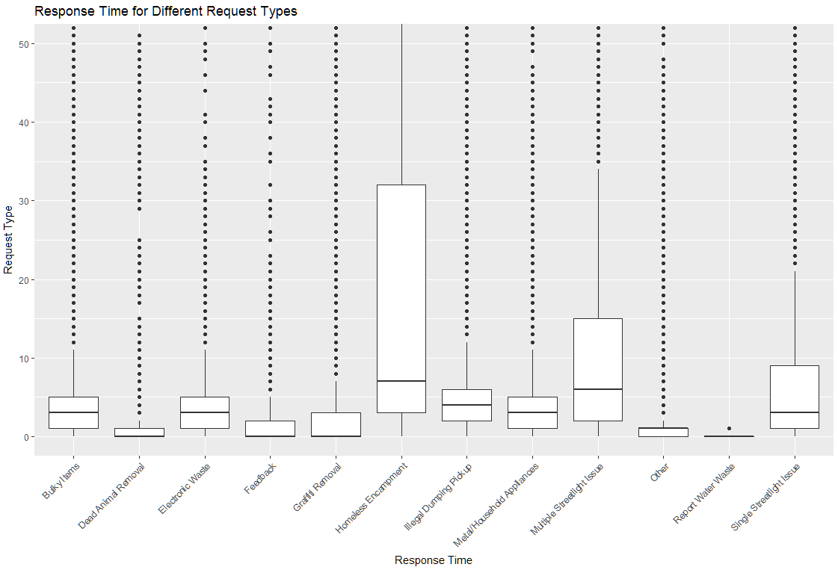
Request Processing Time analysis
Homeless Encampment has the longest response time and largest standard deviation.
The average response time for Homeless Encampment Requests is 27 days
The long response time for Homeless encampment may because both BSS and BOS are handling the request

Slide 8
Findings by Service Type

Slide 9
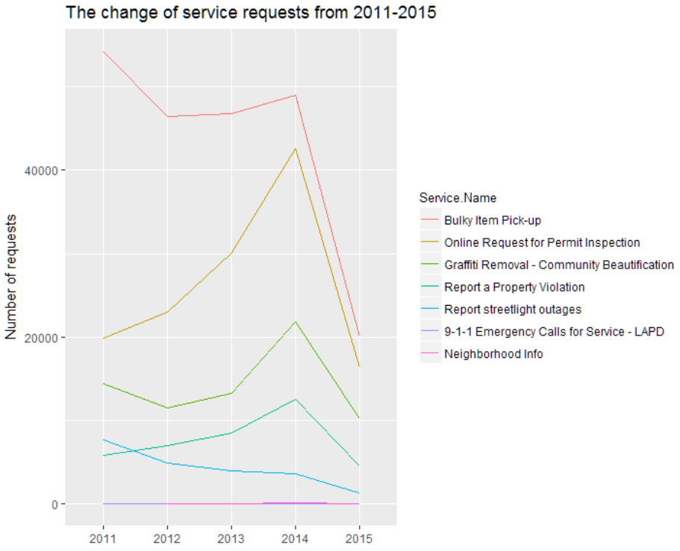
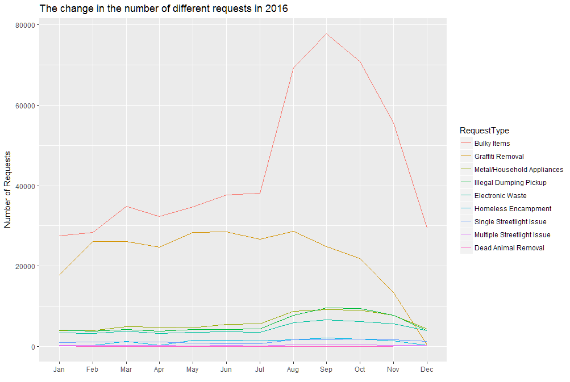
Service type over time
Bulky Items and Graffiti Removal are the top 2 service types throughout 2011-2016. Bulky Items service requests increase in July and peak in Sept. The requests decline significantly after Nov.

Slide 10
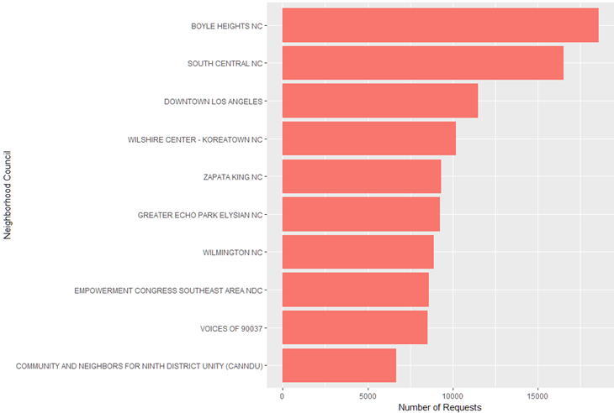
Geographic Analysis on “Graffiti Removal” Requests
“Graffiti Removal” Requests by Neighborhood Council
The top three neighborhood councils that get the most “Graffiti Removal” Requests are
Boyle Heights NC
South Central NC
Downtown LA NC

Slide 11
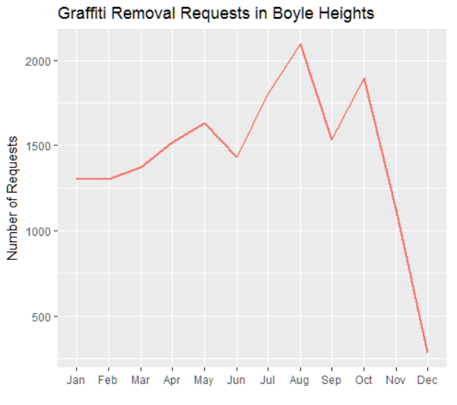
“Graffiti Removal” request in Boyle Heights
The “Graffiti Removal” requests occurred most in August and October and decreased sharply in November and December.
So Office of Community Beautification may want to deploy more resources in August and October in Boyle Heights.

Slide 12
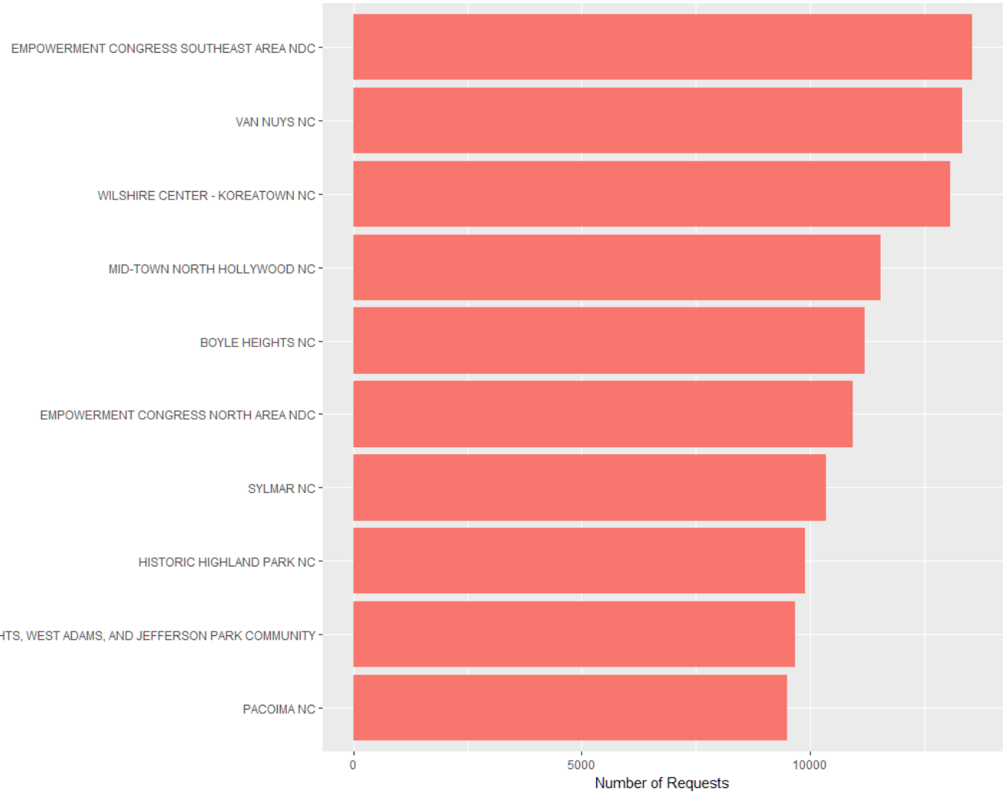
Geographic Analysis on “Bulky Items” Requests
The top three neighborhood with the most “Bulky Items” requests are
SouthEast Area NC
Van Nuys NC
Wilshire Center- KoreaTown NC.

Slide 13
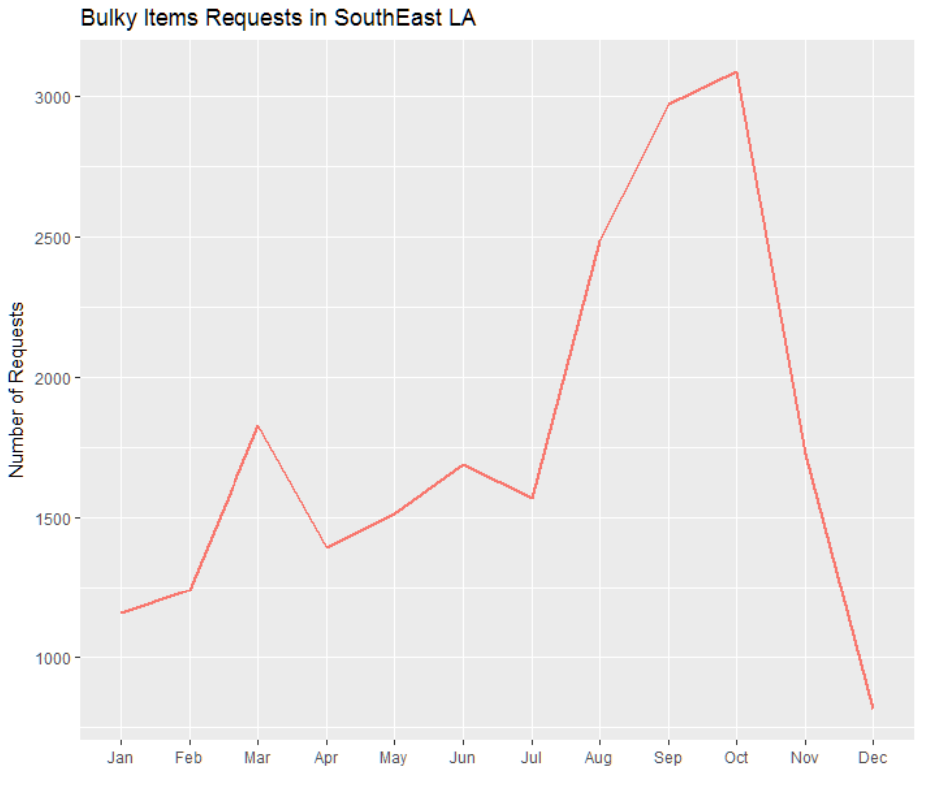
“Bulky Items” Requests in SouthEast Area
The Bulky Items Requests in South East La also shows a clear seasonality.The number of requests increased largely from August to October.
So Bureau of Sanitation may expect a high volume of Bulky Item Cleanup requests during August to October in Southeast LA neighborhood.

Slide 14
Findings by Request Source

Slide 15
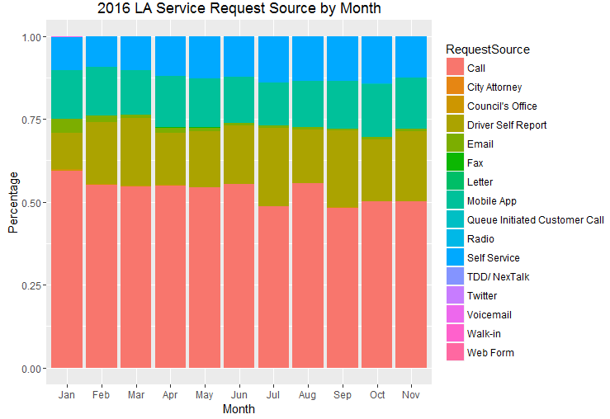
2016 LA Service Request Source
People still prefer requesting services by using phone calls
Government could possibly save costs in phone call operators by promoting LA residents to use mobile app as request resource

Slide 16
Recommendations

Slide 17
Recommendations
Optimize the resource utilization across departments
Distribute the services according to the capacity of department
Eliminate the overlap of responsibilities (Having only one department handle Homeless Encampment Requests)
Allocate seasonal labor in high density areas to control the volume of service requests
Allocate temporary workers / volunteers to handle Bulky Items and Graffiti Removal services in the high density areas in summer (July - Sept.)

Slide 18
Recommendations (Cont.)
Conduct education program to control graffiti
Promote anti-graffiti programs to educate youth in most serious districts
Potential target districts could be: South Central, Boyle Heights (east of Downtown), Echo Park, Pico Union
Promote Mobile APP
Reduce volume of “Calls” to further save labor costs in operators
Improve convenience in reporting incidents

Slide 19
Thank You!
Questions?

Slide 20
Appendix

Slide 21
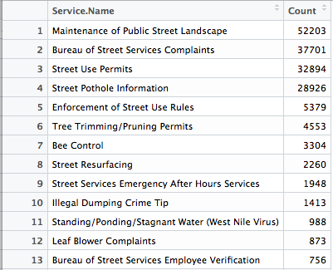
Bureau of Street Service (BSS) Responsibility Change
In 2016
Before 2016
Before 2016, BSS didn’t really processed service. It transferred calls for street related services.
In 2016, BSS is mainly in charge of homeless encampment.

Slide 22
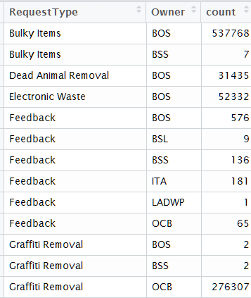
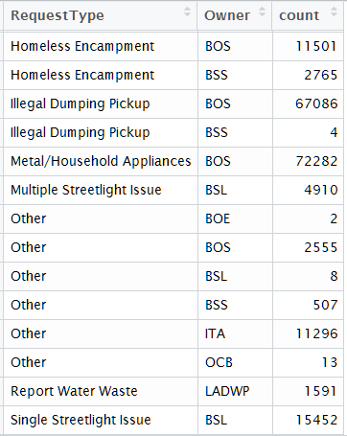
Breakdown of Request Type and Owner
Finding:
Homeless Encampment Requests are both handled by BOS and BSS

Slide 23
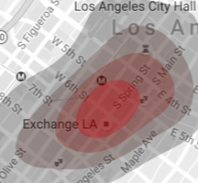
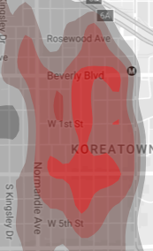
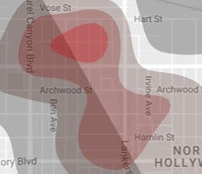
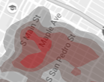
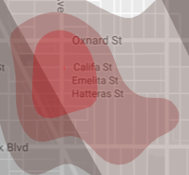

Bulky Items & Graffiti Removal High Density Areas

Slide 24
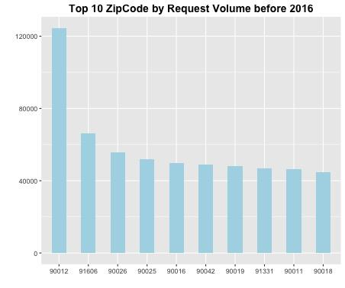
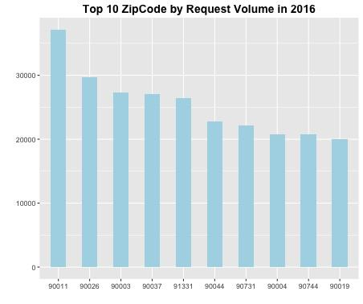
Top 10 Zip Code by Request Volume

Slide 25
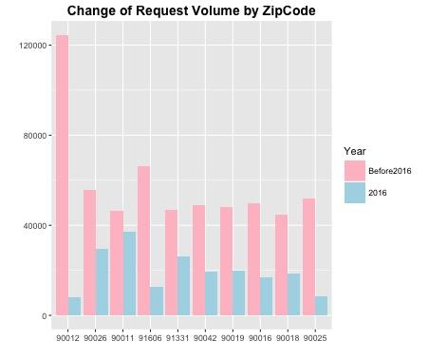
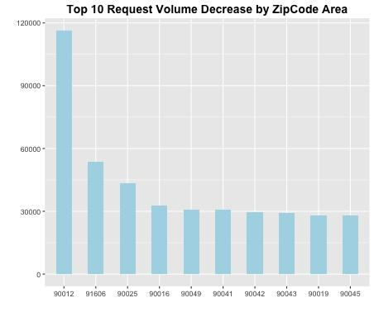
Distribution by Zip Code

Slide 26
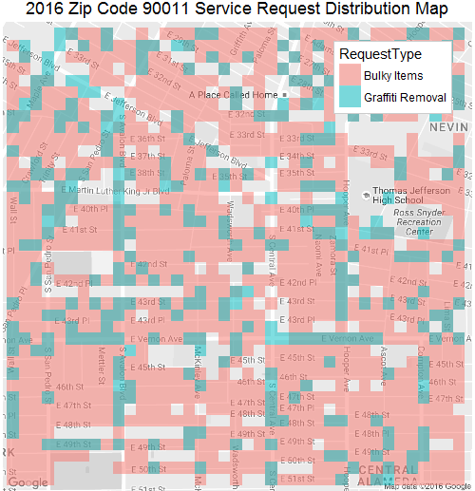
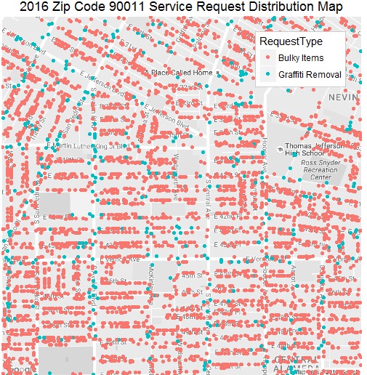
Bulky Items & Graffiti Removal: Zip Code 90011

Slide 27
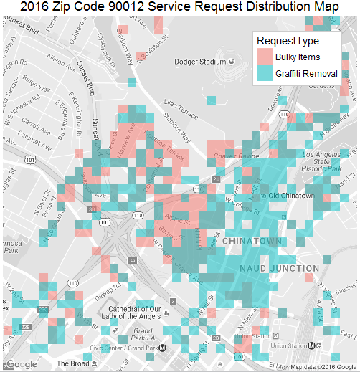
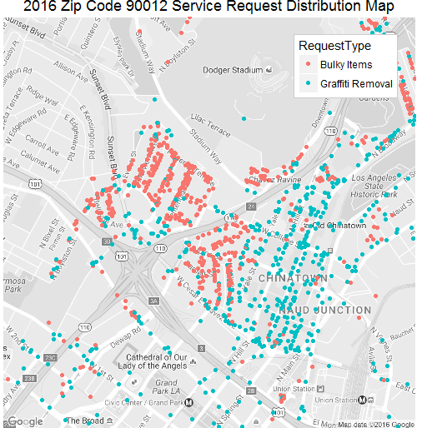
Bulky Items & Graffiti Removal: Zip Code 90012

Slide 28
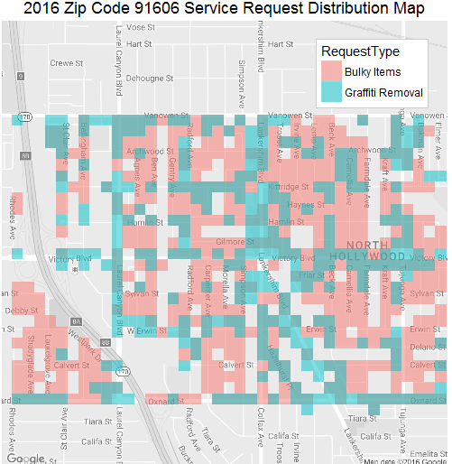
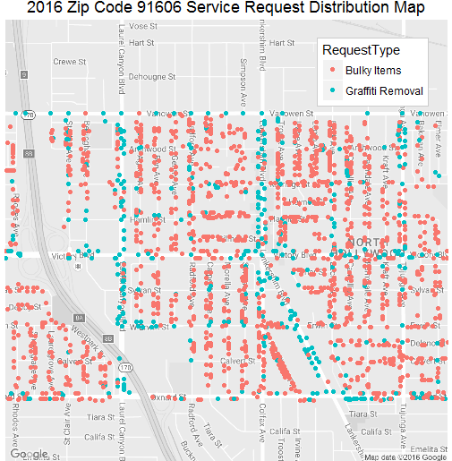
Bulky Items & Graffiti Removal: Zip Code 91606

Slide 29
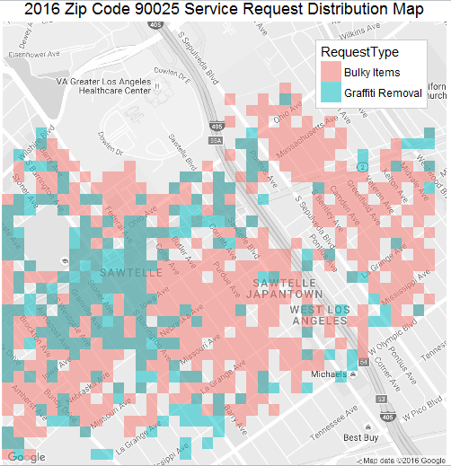
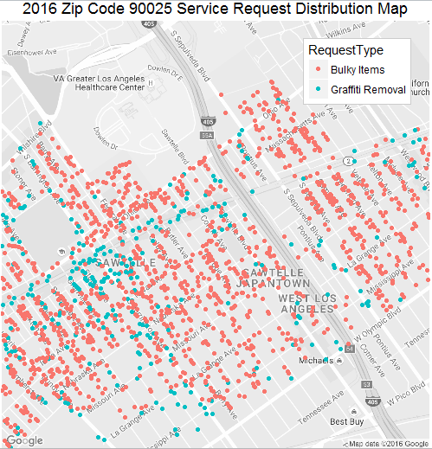
Bulky Items & Graffiti Removal: Zip Code 90025

Slide 30
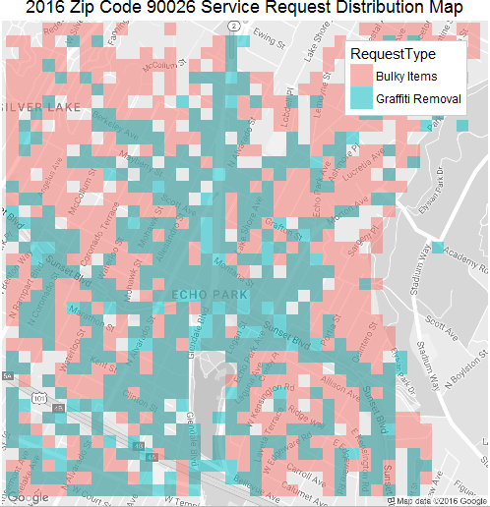
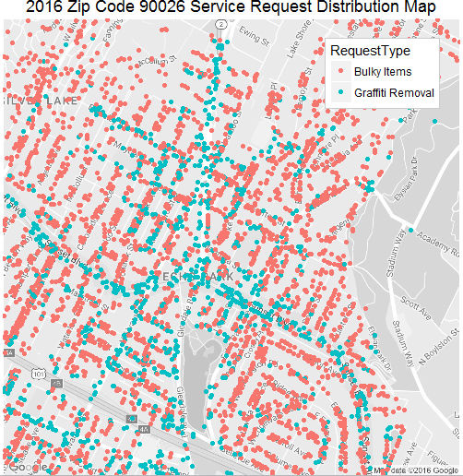
Bulky Items & Graffiti Removal: Zip Code 90025

Slide 31
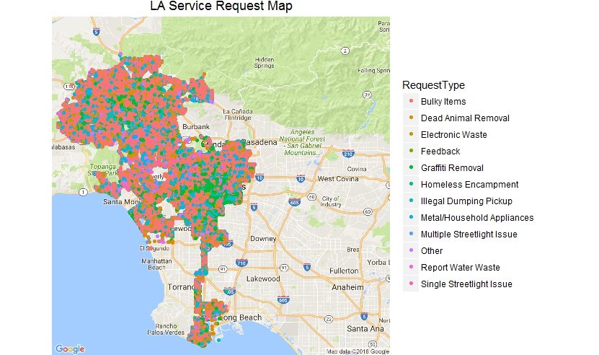
Service Request Distribution in LA Area

Slide 32
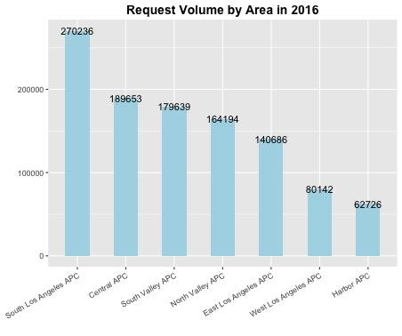
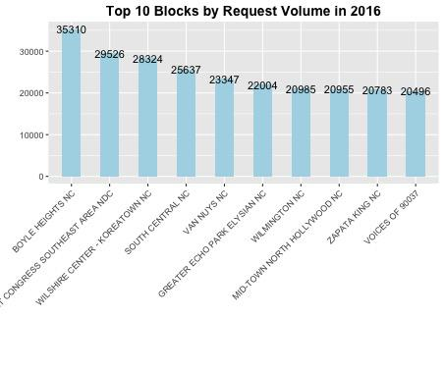
Distribution by Area / Block

Slide 33
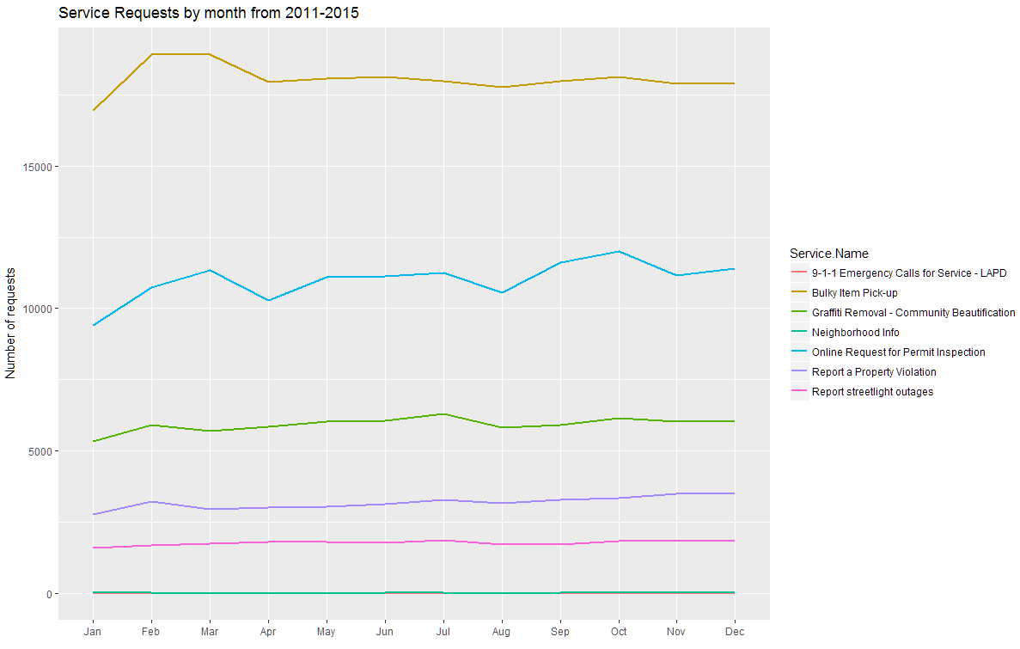
2011 - 2015 Service type by month

Slide 34
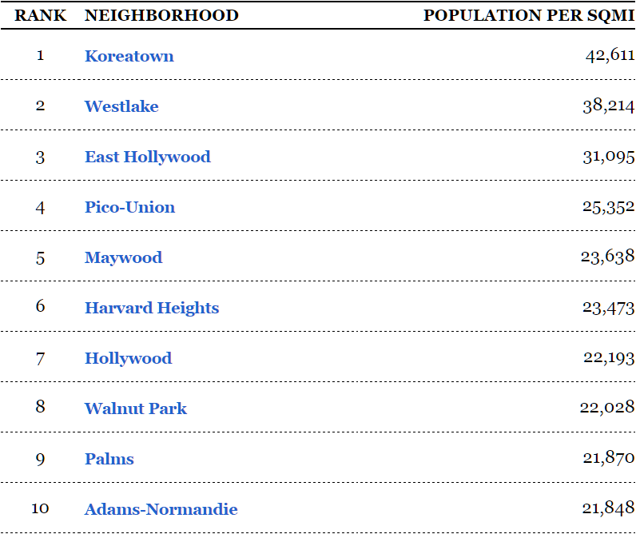
LA neighborhood rank by population
source:http://maps.latimes.com/neighborhoods/population/density/neighborhood/list/

Slide 35
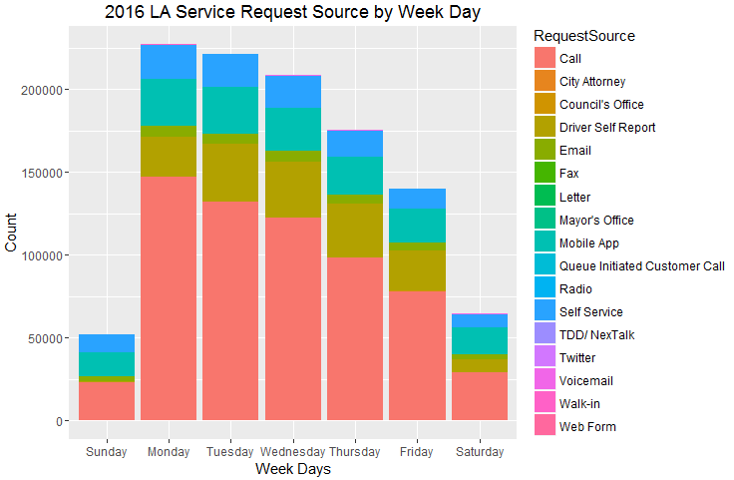
2016 LA Service Request Source by Week Days

Slide 36
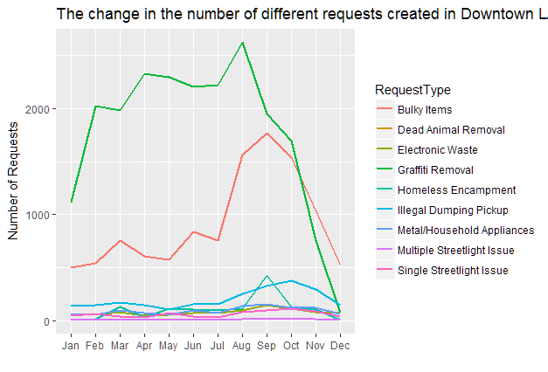
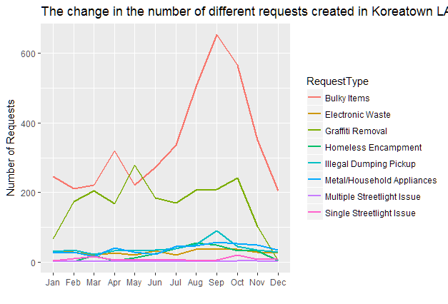
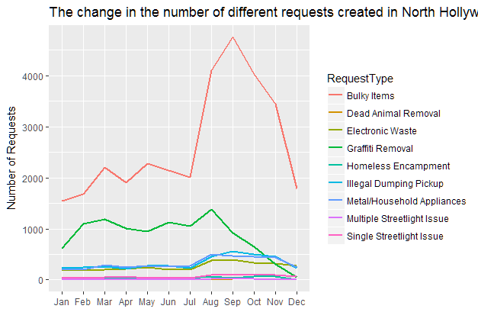
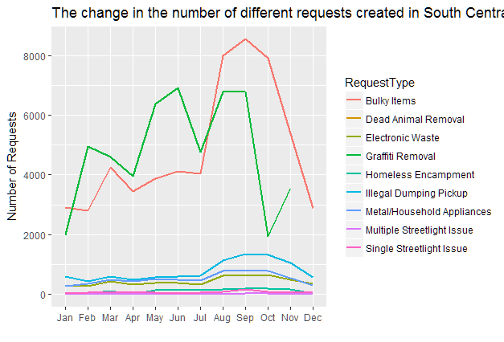
Service type comparison across populous neighborhoods
Downtown LA
Koreatown
North Hollywood
South Central

Slide 37
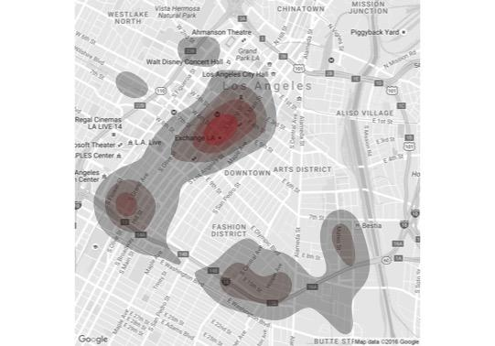
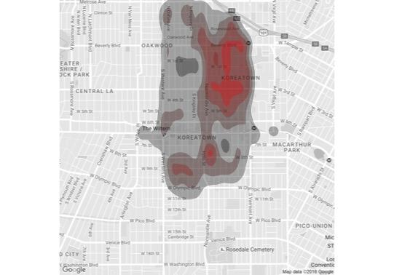
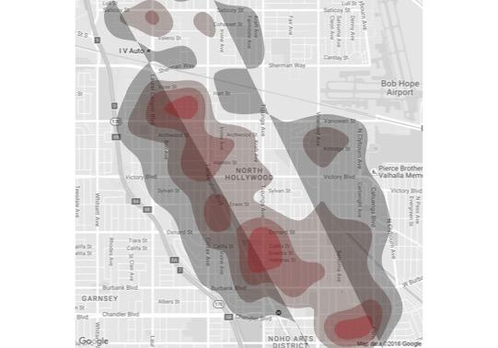

Density of services across neighbourhood
Bulky Items and Graffiti Removal are the top 2 requests
Density of Bulky Items and Graffiti Removal in the neighbourhoods
Downtown LA
Koreatown
North Hollywood
South Central

